Slide 1
Is virtualization a good choice for SQL Server?
Denny Cherry
mrdenny@mrdenny.com
MVP, MCSA, MCDBA, MCTS, MCITP

Slide 2
Agenda
Major Platform Choices
Benefits
Pitfalls
Deciding Factors
Limits of Virtualization
Management Tools
Licensing

Slide 3
Major Platform Choices
VMware
ESX 1-3.5
vSphere 4.0 – 4.1
VMware announced 4.1 will be the last version with a host console 7/30/2010
vSphere Hypervisor (ESXi) 4.0+
Hyper-V
V1 and v2

Slide 4
Benefits
Hardware Costs
Instant Server Deployment
Free Server Redundancy
Live Migration – Hyper-V
vMotion - VMware
Easy System Upgrades

Slide 5
Pitfalls
Shared CPU
Shared Memory
Slow Disk Access times
Another layer of Management
Storage Path Flooding

Slide 6
Deciding Factors
Disk IO
IO Per Seconds
CPU Load
CPU Usage
Core Counts
Processor Queuing
Memory Usage

Slide 7
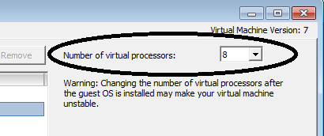
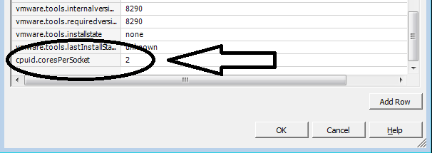
Virtualization Limits
vCPUs must be on the same physical socket
Changed as of vSphere 4.1, requires advanced guest configuration

Slide 8
Virtualization Limits
vMotion or Instant Failover requires hosts have like CPUs models and matching instruction sets
Hyper-V doesn’t include memory de-duplication

Slide 9
Management Tools
VMware requires vCenter to manage a cluster
Hyper-V requires System Center Operations Manager
SCOM can also manage ESX 3.5 or vSphere 4.0 servers (requires vCenter server)

Slide 10
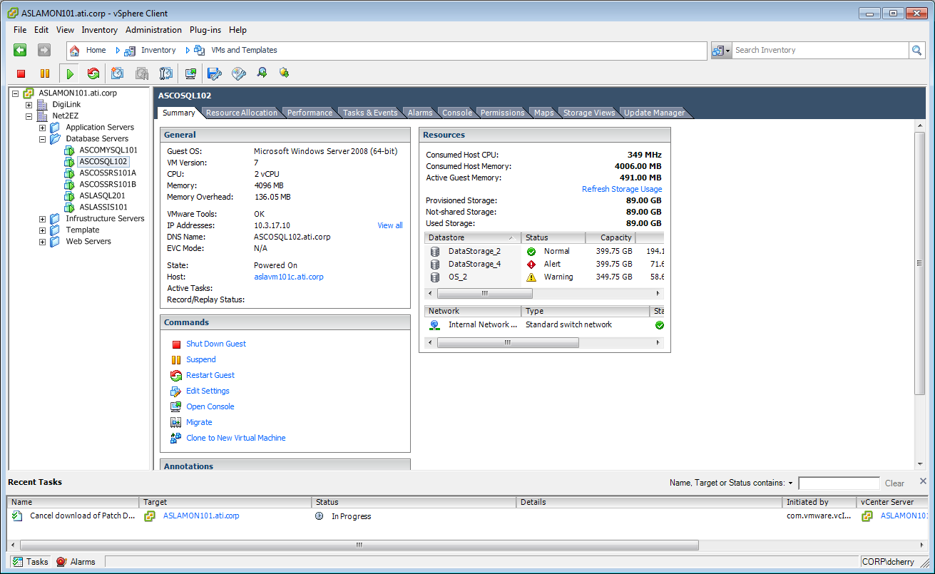
vCenter Client

Slide 11
Licensing
CAL based licensing doesn’t change
1 Server license per guest + CALs for users
CPU licensing
1 license for physical CPU used
1 2008 R2 DCE CPU license for each CPU in host
If you have SQL 2008 R1 with SA for hosts you are grandfathered into SQL 2008 R2. http://bit.ly/cGiatM
Each guest needs a Windows license
Notes:
http://download.microsoft.com/download/2/7/0/270B6380-8B38-4268-8AD0-F480A139AB19/SQL2008R2_LicensingQuickReference-updated.pdf

Slide 12
Monitoring Hosts

Slide 13
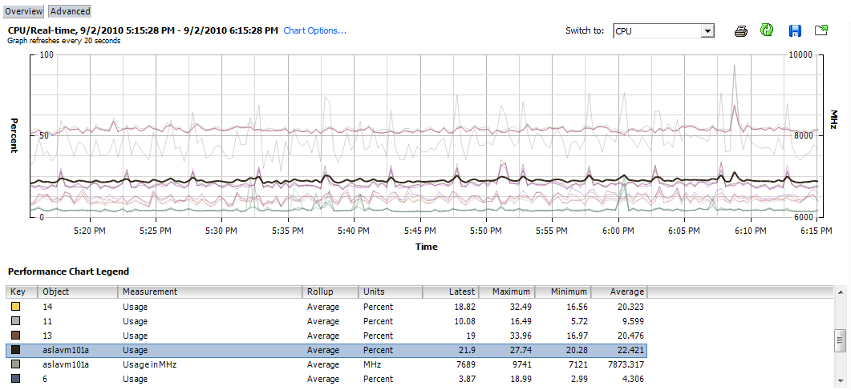
Monitoring Hosts

Slide 14
Monitoring the Guest
Guest CPU Load requires double checking against the host
Disk IO rates are accurate
Disk IO throughput should be confirmed with the host
Disk Latency should be confirmed with the host

Slide 15
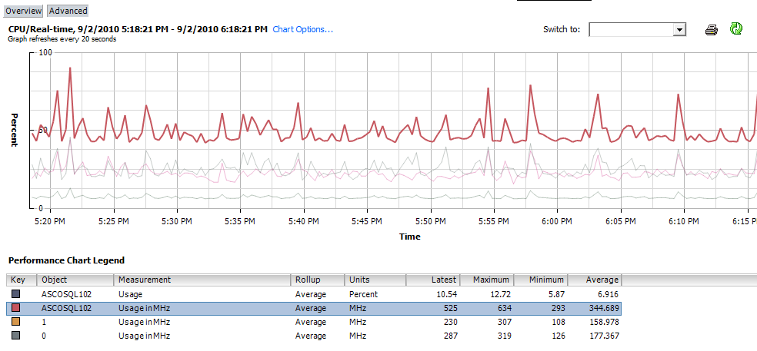
Monitoring the Guest

Slide 16
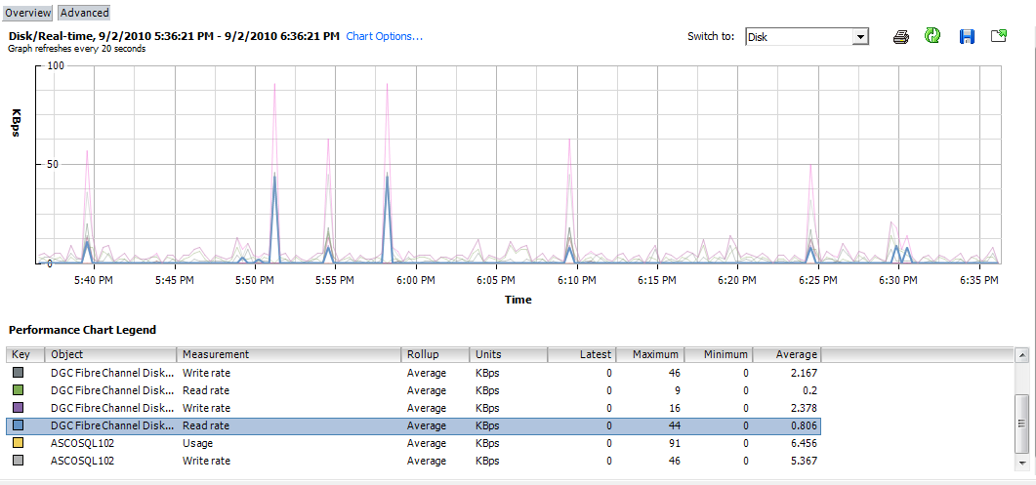
Monitoring the Guest

Slide 17
Want More Virtualization Info?
Come to the SQL PASS Summit in November and sign up for my “Storage and Virtualization for the DBA” pre-con taking place all day on Monday November 8th, 2010.
More info at: http://bit.ly/StorageVirtPreCon

Slide 18
Denny Cherry
mrdenny@mrdenny.com
http://itke.techtarget.com/sql-server
Please fill out the survey at http://speakerrate.com/mrdenny.

